Slide 1



NAMED-ENTITY RECOGNITION FOR HISTORICAL NEWSPAPERS
Outline  | Introduction  | Methodology     | Result   | Discussion    | Conclusion 
Bachelor’s thesis presented by HUYNH Vinh Nam
USTH BI7-114
August 12, 2019

Slide 2
Outline  | Introduction  | Methodology     | Result   | Discussion    | Conclusion  | Page 1
Outline
① Introduction
② Methodology
③ Result
④ Discussion
⑤ Conclusion

Slide 3
Outline  | Introduction  | Methodology     | Result   | Discussion    | Conclusion  | Page 2
About the project
 European Union’s Horizon 2020 programme (agreement No. 770299)
Problem
 Existing NER systems are unable to recognize noisy words
japan ✓
ﬁapan ✗
Solution
 Apply a spelling correction method

Slide 4
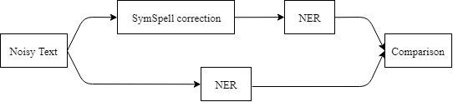

Outline  | Introduction  | Methodology     | Result   | Discussion    | Conclusion  | Page 3
Overview
 Workflow
 Related work: L3i group has run NER over untouched noisy text
 My method: pre-processing noise before parsing paragraph to NER

Slide 5
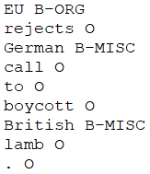
Outline  | Introduction  | Methodology     | Result   | Discussion    | Conclusion  | Page 4
Dataset
 English corpora (CoNLL-2003)
1175 distinct paragraphs
4 classes: PER, LOC, ORG, MISC
BIO format
 OCR noise types simulated:
Word associated with class in dataset
Bleed
DegChar
FantChar
Blur
Notes:
- 945 paragraphs of training/230 paragraphs of testing
- Bleed: Ink bleed through the other side of a double-sized document
- Blur: Blury images undergo OCR
- DegChar: Smudge ink (old papers)
- FantChar: Mold on old papers/worn documents

Slide 6
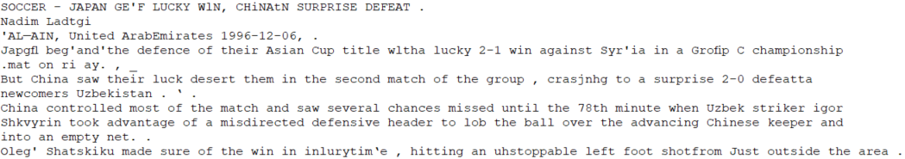
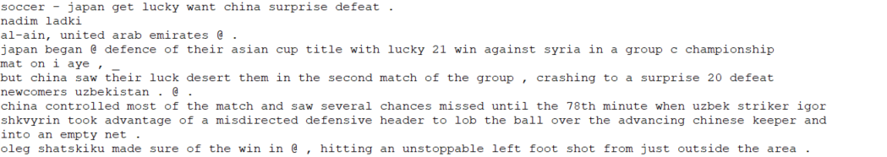
Outline  | Introduction  | Methodology     | Result   | Discussion    | Conclusion  | Page 5
SymSpell correction
Notes:
- Example for DegChar dataset
- SymSpell output presented in lowercase

Slide 7
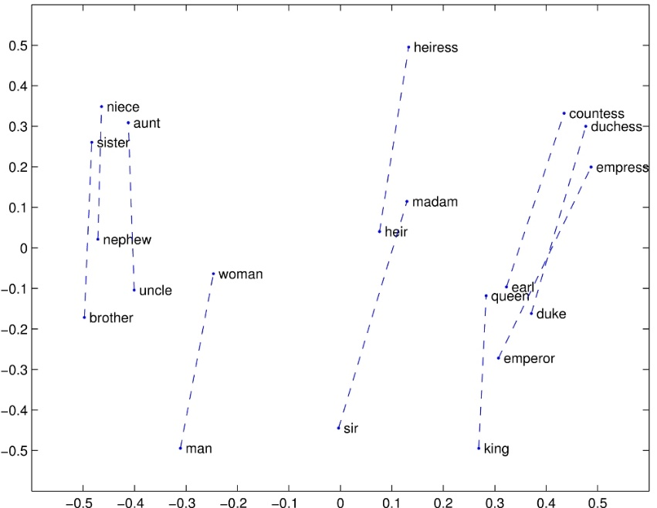
Outline  | Introduction  | Methodology     | Result   | Discussion    | Conclusion  | Page 6
NER models
 GloVe as word embedding
Meaning relationship (co-occurance)
300 dimensions vector
 3 models: from DeLFT tool
① BiLSTM_CRF
② BiLSTM_CNN
③ BiLSTM_CNN_CRF
❖ With all-lowercase data, these models failed to detect any NE!
 Therefore, I generated lowercase dataset. Then re-implemented the tool with uncased GloVe and re-trained these models to work effectively with lowercase paragraph.
Notes:
- Compare to other people who use DeLFT tool for their NER problem, my own work proposes the very first model that deals with uncased paragraphs
- Reason to use DeLFT: L3i also use this tool for NER

Slide 8
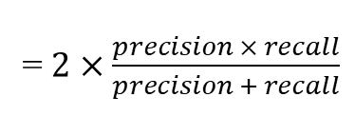
Outline  | Introduction  | Methodology     | Result   | Discussion    | Conclusion  | Page 7
Evaluation
 | Predicted | Predicted
Actual | True Positive (TP) | False Negative (FN)
Actual | False Positive (FP) | True Negative (TN)
 Measure precision and recall
 Calculate f-score
Predict Ground truth
john B-PER john B-PER
lives O lives O
in O in O
new B-ORG new B-LOC
york I-ORG york I-LOC
. O . O
- TP of class PER
- FP of class ORG
- FN of class LOC
= $2×\frac{precision × recall}{precision + recall}$
Notes:
- Precision = TP/(TP+FP)
- Recall = TP/(TP+FN)

Slide 9
Outline  | Introduction  | Methodology     | Result   | Discussion    | Conclusion  | Page 8
F-score
❖ Result will be explained in discussion
Notes:
- Mention about Original (L3i used DeLFT with cased GloVe embedding)

Slide 10
Outline  | Introduction  | Methodology     | Result   | Discussion    | Conclusion  | Page 9
Correction output
 Successfully retrieved correct Named-Entities
OCR: ﬁapan OCR: A||ais
Correction: japan Correction: allais
Truth: Japan (or japan) Truth: Allais (or allais)
OCR: Tatiana Minermayer
Correction: tatiana mittermayer
Truth: Tatiana Mittermayer (or tatiana mittermayer)

Slide 11
Outline  | Introduction  | Methodology     | Result   | Discussion    | Conclusion  | Page 10
Minor problem
 Hyphen words didn’t seem to be treated very well!
OCR: AL-AIN
Correction: again
Truth: AL-AIN (or al-ain)
OCR: Jean-Luc
Correction: @
Truth: Jean-Luc (or jean-luc)
Re-work on
SymSpell dictionary!

Slide 12
Outline  | Introduction  | Methodology     | Result   | Discussion    | Conclusion  | Page 11
Result explanation
 Some noise require larger edit distance to correct (Test set characteristic)
 SymSpell sometime gave wrongful suggestion (due to frequency)
 NER models work also depend on surrounding context
❖ Answer to the problem: Our work is capable of converting Out-of-Vocabulary word (noise) to the most proper word  NER can operate efficiently through SymSpell output

Slide 13
Outline  | Introduction  | Methodology     | Result   | Discussion    | Conclusion  | Page 12
Performance change
 Greatly increased NER performance over blur and degradation dataset
Future works
 Fix dictionary hyphen word bug
 Keep case information
 Use cased model!

Slide 14
Outline  | Introduction  | Methodology     | Result   | Discussion    | Conclusion  | Page 13
Feel free to ask questions!
?

Slide 15
Thank you for your attention!

